Slide 1
To calculate gravitational forces
Do Now
Calculate your weight on Earth, the Moon and the Sun.

Slide 2
Weightlessness and Work
Success Criteria
I can calculate weight and apparent weight in different situations:
- other planetary bodies
- in moving elevators
- during circular motion
I can calculate work done in gravitational fields.

Slide 3
To calculate weight and apparent weight
Content Development
An object’s weight is the force it experiences due to gravity. This does not change unless it moves to a very different altitude.
An object’s apparent weight is the normal reaction force that it experiences
This can be different in certain situations such as:
  Accelerating upwards or downwards
  Undergoing vertical circular motion (which is also technically accelerating upwards or downwards)
Notes:
ΔPE = mgΔh = 1*9.8*1 = 9.8 J

Slide 4

To calculate weight and apparent weight
Content Development
Calculate the weight and apparent weight of this 80 kg person in an elevator
stationary
accelerating up at 1.26 ms⁻²
accelerating down at 1.26 ms⁻²
F_{net}
F_{net}
F_{g}
F_{N}
F_{g}
F_{g}
F_{N}
F_{N}
Weight force is constant. Net force is given by the acceleration.
Normal force changes to match. Always check answer with your diagram.
Notes:
W = 784 = Fnormal
Fnet = ma = 80 * 1.26 = 100.8 N
Fnet = Fn – Fg
Fn = Fnet + Fg = 100.8 + 784 = 884.8 N
c) Fnet = 100.8N
Fnet = Fg – Fn
Fn = Fg – Fnet = 784 – 100.8 = 683.2 N

Slide 5
To calculate weight and apparent weight
Content Development
Apparent weightlessness is equivalent to not experiencing a normal reaction force.
Any object in free-fall (whether falling off a table, jumping from a plane or orbiting the Earth) will experience apparent weightlessness.
This can be different in certain situations such as:
  Accelerating upwards or downwards
  Undergoing vertical circular motion (which is also technically accelerating upwards or downwards)
Notes:
ΔPE = mgΔh = 1*9.8*1 = 9.8 J

Slide 6
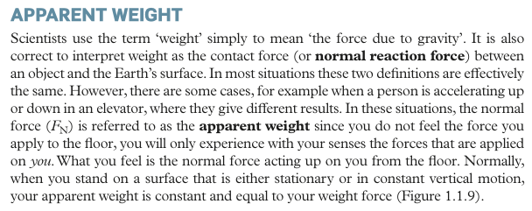
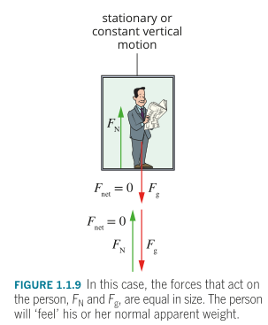
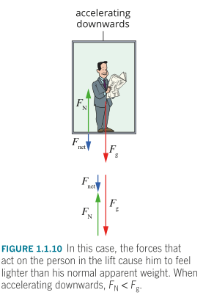
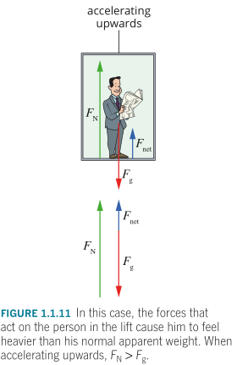
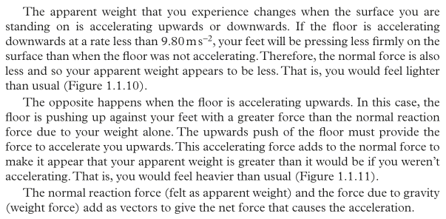
Apparent Weight
Reminder

Slide 7
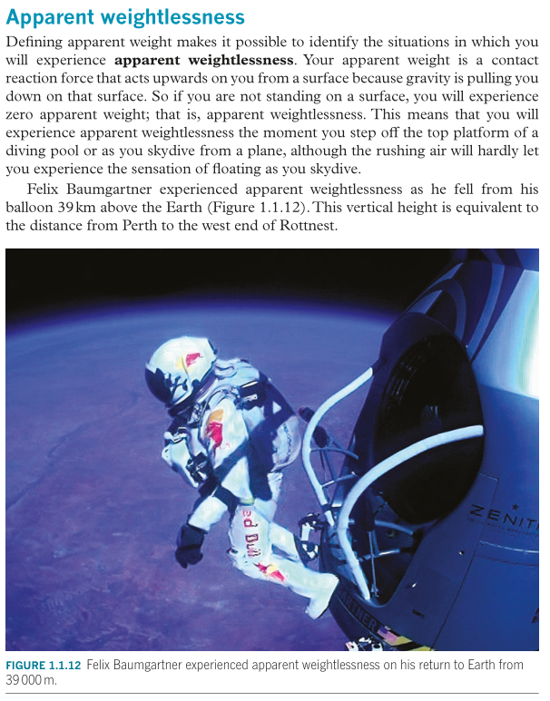
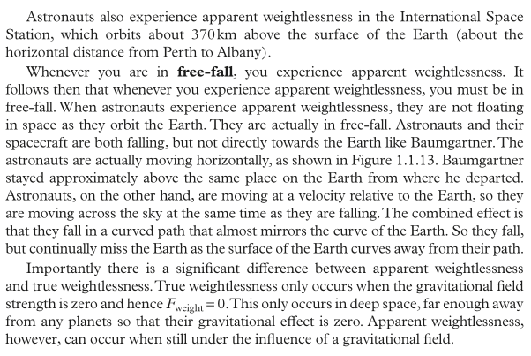
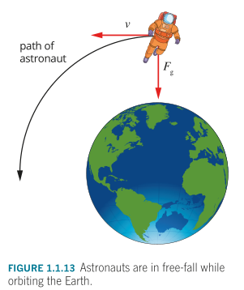
Apparent Weightlessness
Content development

Slide 8
Weightlessness and Work
Success Criteria
I can calculate weight and apparent weight in different situations:
- other planetary bodies
- in moving elevators
- during circular motion
I can calculate work done in gravitational fields.

Slide 9

To calculate work in a gravitational field
Content Development
Calculate the change in potential energy of the book when it is moved onto the box.
1m
1kg
The work done by a gravitational field is equal to the change in its gravitational potential energy.
Notes:
ΔPE = mgΔh = 1*9.8*1 = 9.8 J

Slide 10
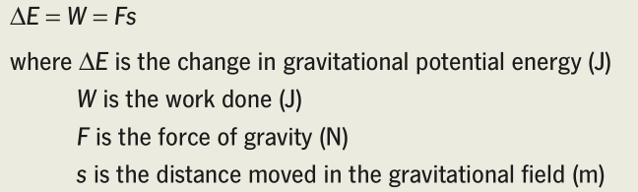
To calculate work in a gravitational field
Content Development
The work done by a gravitational field is equal to the change in its gravitational potential energy.
Notes:
PE = mgΔh = 160*9.8*0.8 = 1.254*10^3 = 1.25*10^3 J
The barbell is lifted at a constant velocity (“steadily”)
v = s/t = 0.8/2.8 = 0.2857 ms^-1
KE = 0.5mv^2 = 6.53 J
c) W = ΔE = PE + KE = 1.254*10^3 + 6.53 = 1.26*10^3 J

Slide 11
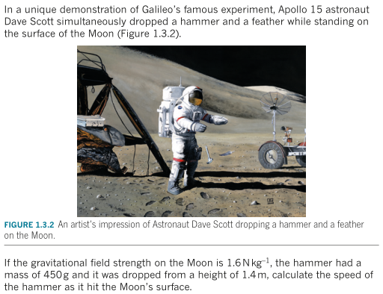
To calculate work in a gravitational field
Content Development
Notes:
Eg = mgΔh = 0.45*1.6*1.4 = 1 J
Ek = Eg = 1 J
Ek = 0.5mv^2
v = 2.1 m/s

Slide 12
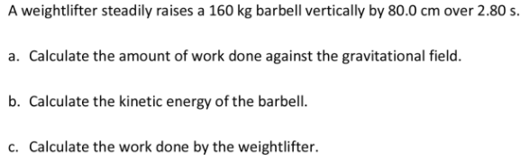
To calculate work in a gravitational field
Draw a picture!!
Do Now
Notes:
PE = mgΔh = 160*9.8*0.8 = 1.254*10^3 = 1.25*10^3 J
The barbell is lifted at a constant velocity (“steadily”)
v = s/t = 0.8/2.8 = 0.2857 ms^-1
KE = 0.5mv^2 = 6.53 J
c) W = ΔE = PE + KE = 1.254*10^3 + 6.53 = 1.26*10^3 J

Slide 13
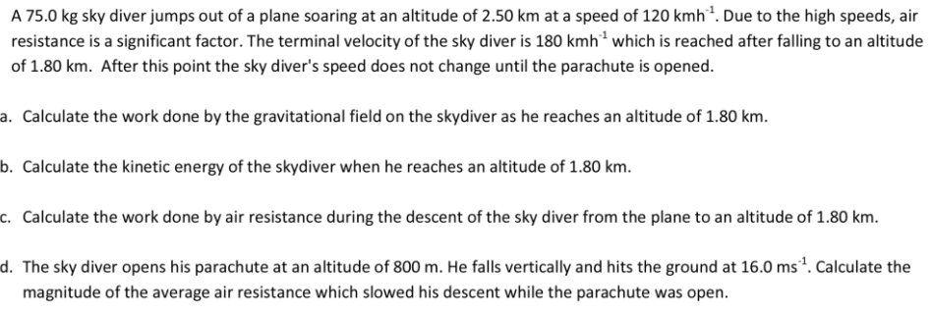
To calculate work in a gravitational field
Draw a picture!!
Hard Question
Note: magnitude of average air resistance is a force
Note: include initial kinetic energy in your calculations
Note: this is harder than a simple energy balance because of air resistance. It is no longer a closed system.

Slide 14
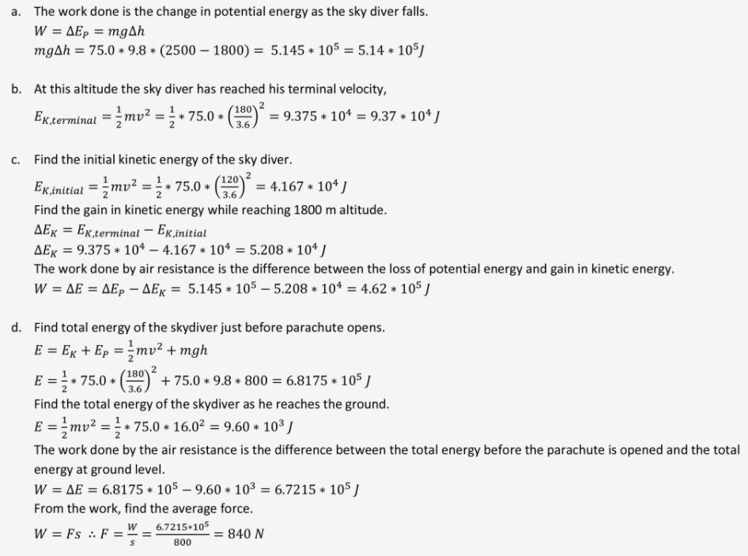
To calculate work in a gravitational field
Draw a picture!!
Do Now

Slide 15
Weightlessness and Work
Success Criteria
I can calculate weight and apparent weight in different situations:
- other planetary bodies
- in moving elevators
- during circular motion
I can calculate work done in gravitational fields.

Slide 16
Satellites
Success Criteria
I can analyse the motion of satellites in circular orbits

Slide 17
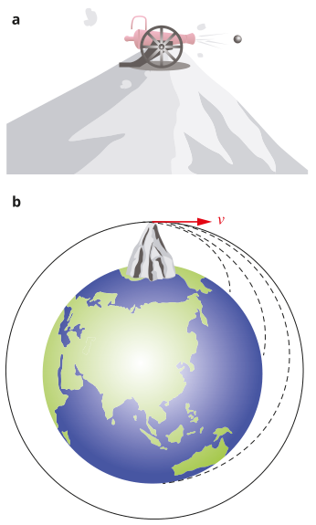
Newton’s Cannonball
Content Development
Isaac Newton had a famous thought experiment known as Newton’s Cannonball. He imagined a cannon sitting on a tall mountain. As the cannon is fired, the force of gravity pulls the cannonball down to Earth. But if you fire it faster, it will travel further before it lands.
If you can fire it fast enough, it would travel all the way around the Earth and reach its starting point again.
Calculate that velocity
(ignoring air resistance)
Notes:
Fnet = mg = mv^2/r
v = sqrt(g*r) = sqrt ( 9.8 * 6.37*10^6) = 7901 m/s = 7.9 km/s = 28,462 km/h
https://en.wikipedia.org/wiki/Newton%27s_cannonball
https://spatrick.mit.edu/newtons-cannon
https://physics.weber.edu/schroeder/software/NewtonsCannon.html

